Slide 1







FACRAO 2026 - HIGHER EDUCATION SUMMIT
the gameplan to student success
CORPORATE PARTNER SPONSORSHIP GUIDE
JUNE 7-10, 2026
JACKSONVILLE, FLORIDA

Slide 2
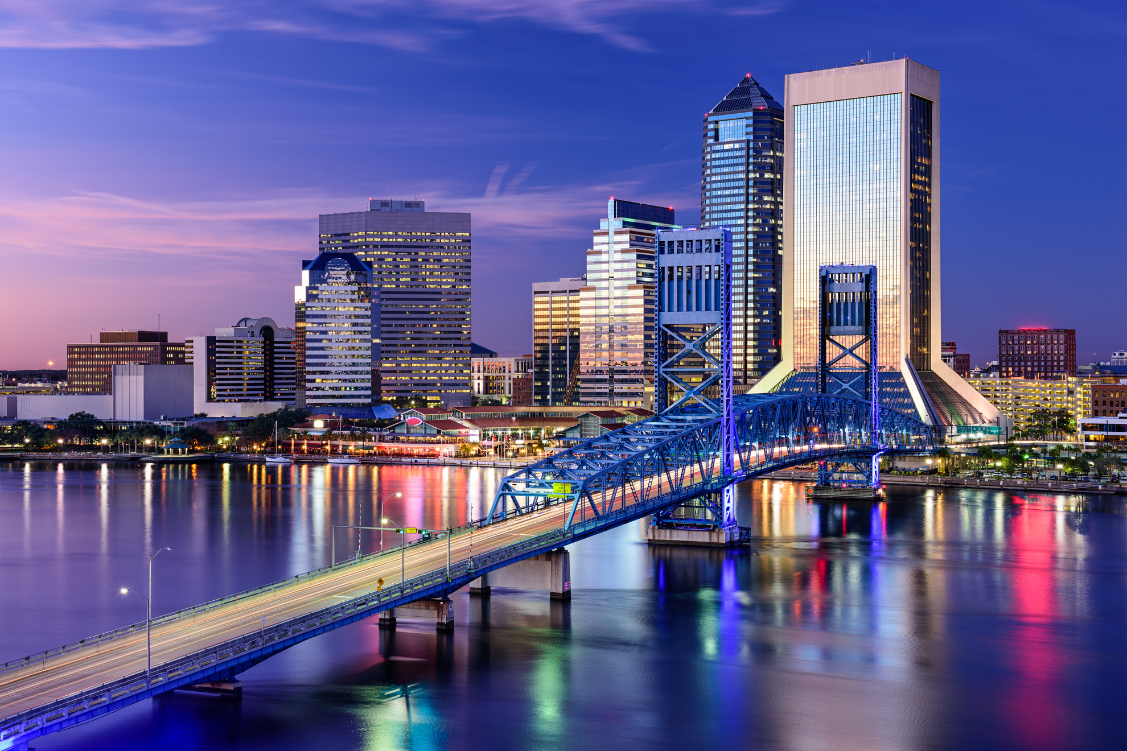
facrao 2026
FACRAO invites your organization to step onto the field as a sponsor for the 2026 Florida Higher Education Summit.
This event brings together enrollment leaders from Public and Private Colleges and Universities in the State of Florida. It is a great opportunity to showcase your company and meet professionals from a variety of higher education institutions.
Thank you for your support and we look forward to seeing you in Jacksonville, Florida!

Slide 3

EXHIBITOR LEVEL
$650.00
EIGHT (7) SPOTS AVAILABLE
rising star sponsor
One 8' table and two chairs provided in Exhibitor Area to be staffed during exhibitor hours* (maximum of two registered representatives - additional fee(s) apply for additional table/people).
Company name, logo, and link on the FACRAO website and conference app under the Exhibitor section.
Right to sell products or services on site.
Attendance for two reps to attend all conference meals/functions.
**Additional fees for extra reps and/or rep guest(s) will apply.**

Slide 4

SPONSORSHIP LEVEL ONE
$2,500.00
first time attendee welcome sponsor
INCLUDES EXHIBTIOR LEVEL PACKAGE AND:
Company name, logo, and link on the FACRAO website and in the mobile conference app under both the Sponsors and Exhibitors sections.
Signage recognizing sponsor at event location.
Option to do a presentation during the conference.
Slide recognition at opening and closing events.
Conference attendees contact information.
**Additional fees for extra reps and/or rep guest(s) will apply.**

Slide 5

SPONSORHIP LEVEL ONE
$2,500.00
facrao scholarship sponsor
INCLUDES EXHIBTIOR LEVEL PACKAGE AND:
Company name, logo, and link on the FACRAO website and in the mobile conference app under both the Sponsors and Exhibitors sections.
Company name, logo, and link on the FACRAO Scholarship page for one year
Option to do a presentation during the conference.
Slide recognition at opening and closing events
Professional Photograph with recipients
Special recognition within the conference app and featured on the FACRAO website.
Conference attendees contact information.
**Additional fees for extra reps and/or rep guest(s) will apply.**

Slide 6

SPONSORSHIP LEVEL ONE
$2,500.00
conferencepresenter gift sponsor
INCLUDES EXHIBTIOR LEVEL PACKAGE AND:
Company name, logo, and link on the FACRAO website and in the mobile conference app under both the Sponsors and Exhibitors sections.
Company name and logo to be prominently displayed on gift given to each conference presenter.
Option to do a presentation during the conference.
Slide recognition at opening and closing events.
Conference attendees contact information.
** Additional fees for extra reps and/or rep guest(s) will apply.**

Slide 7


SPONSORSHIP LEVEL ONE
$2,500.00
conferenceshirt sponsor
INCLUDES EXHIBTIOR LEVEL PACKAGE AND:
Company name, logo, and link on the FACRAO website and in the mobile conference app under both the Sponsors and Exhibitors sections.
Company name and logo to be prominently displayed on conference shirts (worn by the Executive Committee Members during check-in and at multiple conference functions).
Option to do a presentation during the conference.
Slide recognition at opening and closing events.
Conference attendees contact information.
**Additional fees for extra reps and/or rep guest(s) will apply.**

Slide 8

SPONSORSHIP LEVEL ONE
$2,500.00
“go team”
theme sponsor
INCLUDES EXHIBTIOR LEVEL PACKAGE AND:
Company name, logo, and link on the FACRAO website and in the mobile conference app under both the Sponsors and Exhibitors sections.
Company name and/or logo to be prominently displayed on conference themed giveaway.
Option to do a presentation during the conference.
Slide recognition at opening and closing events.
Conference attendees contact information.
**Additional fees for extra reps and/or rep guest(s) will apply.**

Slide 9

SPONSORSHIP LEVEL ONE
PURCHASED
conference app sponsor
INCLUDES EXHIBTIOR LEVEL PACKAGE AND:
Company name, logo, and link on the FACRAO website and in the mobile conference app under both the Sponsors and Exhibitors sections.
Special recognition within the conference app.
Option to do a presentation during the conference.
Slide recognition at opening and closing events.
Conference attendees contact information.
**Additional fees for extra reps and/or rep guest(s) will apply.**

Slide 10

SPONSORSHIP LEVEL TWO
$3,000.00
refreshment break sponsor
INCLUDES EXHIBTIOR LEVEL PACKAGE AND:
Company name, logo, and link on the FACRAO website and in the mobile conference app under both the Sponsors and Exhibitors sections.
Signage recognizing sponsored break.
Option to do a presentation during the conference.
Slide recognition at opening and closing events.
Special recognition within the conference app
Conference attendees contact information.
There are 4 sponsorships available in this category
Monday AM
Monday PM
Tuesday AM
Tuesday PM
**Additional fees for extra reps and/or rep guest(s) will apply.**

Slide 11



SPONSORSHIP LEVEL TWO
PURCHASED
badge holder sponsor
INCLUDES EXHIBTIOR LEVEL PACKAGE AND:
Company name, logo, and link on the FACRAO website and in the mobile conference app under both the Sponsors and Exhibitors sections.
Company name and logo prominently displayed on badge holders (lanyards) worn by all registered attendees.
Option to do a presentation during the conference.
Slide recognition at opening and closing events
Conference attendees contact information.
**Additional fees for extra reps and/or rep guest(s) will apply.**

Slide 12

SPONSORSHIP LEVEL TWO
PURCHASED
professional development sponsor
INCLUDES EXHIBTIOR LEVEL PACKAGE AND:
Company name, logo, and link on the FACRAO website and in the mobile conference app under both the Sponsors and Exhibitors sections.
Signage recognizing sponsor at event location.
Option to do a presentation during the conference.
Slide recognition at opening and closing events
Special recognition within the conference app and featured on the FACRAO website.
Conference attendees contact information.
**Additional fees for extra reps and/or rep guest(s) will apply.**

Slide 13

SPONSORSHIP LEVEL TWO
$3,000.00
conference wi-fi sponsor
INCLUDES EXHIBTIOR LEVEL PACKAGE AND:
Company name, logo, and link on the FACRAO website and in the mobile conference app under both the Sponsors and Exhibitors sections.
Company name and logo on Wi-Fi password cards.
Option to do a presentation during the conference.
Slide recognition at opening and closing events
Special recognition within the conference app
Conference attendees contact information
**Additional fees for extra reps and/or rep guest(s) will apply.**

Slide 14

SPONSORSHIP LEVEL THREE
PURCHASED
opening keynote session sponsor
INCLUDES EXHIBTIOR LEVEL PACKAGE AND:
Company name, logo, and link on the FACRAO website and in the mobile conference app under both the Sponsors and Exhibitors sections.
Signage recognizing sponsor at event location.
Slide recognition at opening and closing events
Special recognition on Conference Keynote Speaker page on the FACRAO website
Option to do a presentation during the conference.
Option to send 1 mass notification through mobile conference app to all registered attendees
Conference App push before presentation
2-3 minute opportunity at opening of keynote to share information about products/services and introduce speaker.
Insert for conference bags
**Additional fees for extra reps and/or rep guest(s) will apply.**

Slide 15

SPONSORSHIP LEVEL THREE
$3,500.00
president’s reception food/beverage sponsor
INCLUDES EXHIBTIOR LEVEL PACKAGE AND:
Company name, logo, and link on the FACRAO website and in the mobile conference app under both the Sponsors and Exhibitors sections.
Signage recognizing sponsor at event location.
Option to do a presentation during the conference.
Conference App push before presentation
Slide recognition at opening and closing events
Special recognition within the conference app
Conference attendees contact information.
Option to send 2 mass notification through mobile conference app to all registered attendees
Insert for conference bags.
**Additional fees for extra reps and/or rep guest(s) will apply.**

Slide 16

SPONSORSHIP LEVEL THREE
$3,500.00
big event entertainment sponsor
INCLUDES EXHIBTIOR LEVEL PACKAGE AND:
Company name, logo, and link on the FACRAO website and in the mobile conference app under both the Sponsors and Exhibitors sections.
Signage recognizing sponsor at event location.
Option to do a presentation during the conference.
Conference App push before presentation
Slide recognition at opening and closing events
Special recognition within the conference app
Conference attendees contact information.
Option to send 1 mass notification through mobile conference app to all registered attendees
Insert for conference bags
**Additional fees for extra reps and/or rep guest(s) will apply.**

Slide 17
SPONSORSHIP LEVEL THREE
$3,500.00
big event food/beverage sponsor
INCLUDES EXHIBTIOR LEVEL PACKAGE AND:
Company name, logo, and link on the FACRAO website and in the mobile conference app under both the Sponsors and Exhibitors sections.
Signage recognizing sponsor at event location.
Option to do a presentation during the conference.
Conference App push before presentation
Slide recognition at opening and closing events
Special recognition within the conference app
Conference attendees contact information.
Option to send 2 mass notification through mobile conference app to all registered attendees
Insert for conference bags
There are multiple sponsorship opportunities
Food - $3,500
Beverage - $3,500
If same sponsor, both - $6,500
**Additional fees for extra reps and/or rep guest(s) will apply.**

Slide 18


SPONSORSHIP LEVEL THREE
$3,500.00
business meeting
luncheon
sponsor
INCLUDES EXHIBTIOR LEVEL PACKAGE AND:
Company name, logo, and link on the FACRAO website and in the mobile conference app under both the Sponsors and Exhibitors sections.
Signage recognizing sponsor at event location.
Conference App push before presentation
Slide recognition at opening and closing events
Special recognition within the conference app
Conference attendees contact information.
Option to send 2 mass notification through mobile conference app to all registered attendees
Insert for conference bags
Option to do a 2-3 minute opportunity at opening of business meeting to share information about products/services.
**Additional fees for extra reps and/or rep guest(s) will apply.**

Slide 19


SPONSORSHIP LEVEL FOUR
$4,000.00
conference tote bag
INCLUDES EXHIBTIOR LEVEL PACKAGE AND:
Company name, logo, and link on the FACRAO website and in the mobile conference app under both the Sponsors and Exhibitors sections.
Company name and logo on conference bag provided at check-in for all registered attendees.
Option to do a presentation during the conference.
Conference App push before presentation
Slide recognition at opening and closing events
Conference attendees contact information.
Option to send 2 mass notification through mobile conference app to all registered attendees
Insert for conference bags
**Additional fees for extra reps and/or rep guest(s) will apply.**

Slide 20

DOOR PRIZE GIVEAWAYS
First Time Attendees Session
Big Event
Business Meeting/Luncheon
FACRAO Executive Committee Led Sessions
NEW OPTIONS
Ask about personalized opportunities to sponsor:
Past President’s Lunch
Welcome to FACRAO 2026 (Sunday)
Executive Committee Appreciation Lunch
Departure Day “Lunch to Go” boxes
Vendors must purchase a sponsorship level package to participate in additional opportunities.
*Limited opportunities available, please contact Dulce Beltran at sponsorship@facrao.org for
additional information*
additional opportunities

Slide 21
Thank you for your support and we look forward to partnering with you!
Please contact Dulce Beltran
Corporate Partner Liaison
for additional information at: sponsorship@facrao.org

